Slide 1

Project Title -Seasonal Agriculture Performance Analysis
Student Name - SAHIL KUMAR DHIWAR
College Name – Chhattisgarh Institute of Technology Jagdalpur
AICTE STU ID : (STU6a16e528793f61779885352)

Slide 2

PROBLEM STATEMENT
Agricultural activities are influenced by seasonal variations in environmental conditions, farming practices, resource availability and market conditions. As a result, agricultural performance may differ from one season to another. However, raw agricultural data does not clearly explain how agricultural performance changes across seasons or what patterns can be observed in different seasonal conditions. The problem is to analyze the given agricultural dataset and investigate seasonal differences in agricultural performance by identifying meaningful patterns, trends, relationships and variations within the available data.

Slide 3
Project Description
This project, Seasonal Agriculture Performance Analysis, is a data analytics study of a farm-level agricultural dataset covering 4,000 records across the Kharif, Rabi and Zaid seasons, multiple states/districts, 8 crops and 4 irrigation methods.
The dataset combines environmental conditions (rainfall, temperature, humidity, soil health), farming inputs (fertilizer, pesticide, irrigation) and economic outcomes (cost, revenue, profit, ROI), enabling a season-wise view of agricultural performance.
Using Python (Pandas, NumPy, Matplotlib, Seaborn), the data was cleaned, explored and analyzed through univariate, bivariate, multivariate and correlation analysis, followed by three custom student-designed analyses (ROI by crop, irrigation efficiency, and environmental drivers of pest risk).
The end result is a set of evidence-based insights and recommendations to help stakeholders plan crops, irrigation and resources more effectively across seasons.

Slide 4

WHO ARE THE END USERS?
Farmers & Agronomists – compare seasonal performance and choose crops, irrigation methods and inputs more effectively.
Agricultural Policy Makers & Government Bodies – support evidence-based seasonal planning and resource allocation.
Agri-business & Agri-tech Companies – identify seasonal demand patterns and design targeted products/services.
Financial & Insurance Institutions – assess seasonal risk and profitability for lending and crop insurance.
Researchers & Agricultural Universities – study seasonal trends and environmental impact on productivity.

Slide 5

Technology Used
Python –and numcore programming language for the analysis.
Pandas & NumPy – data loading, cleaning erical computation.
Matplotlib & Seaborn – univariate, bivariate, multivariate and correlation visualizations.
Google Colab – interactive development and documentation environment.
CSV Dataset – seasonal agriculture performance dataset with 4,000 records and 28 features.

Slide 6
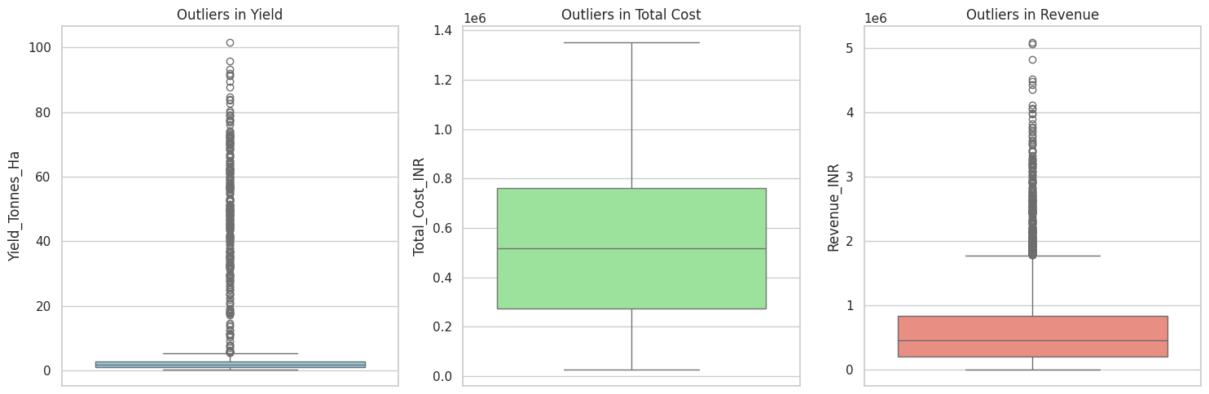
RESULTS Data Cleaning & Outlier Detection
Boxplots were used to detect outliers in Yield, Total Cost and Revenue. Missing values in Rainfall, Yield and Soil Moisture were imputed using season/crop-wise medians, and duplicate records were removed before analysis.

Slide 7
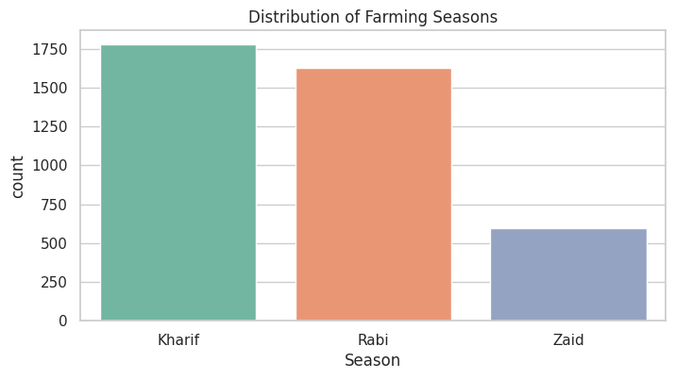
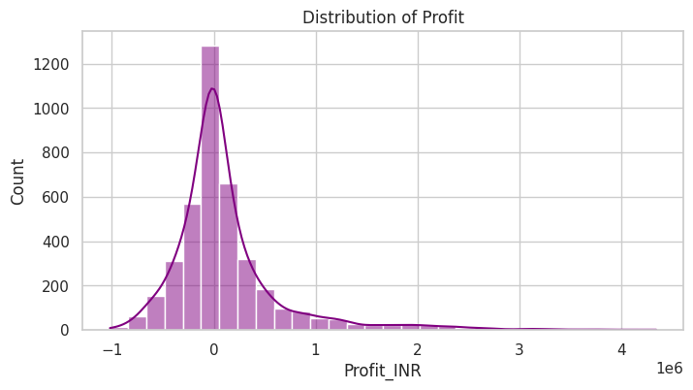
RESULTS Univariate Analysis
Kharif is the most common farming season, followed by Rabi and Zaid. Profit is right-skewed: most farms earn modest profits, while a smaller number of high performers pull the distribution's tail to the right.

Slide 8
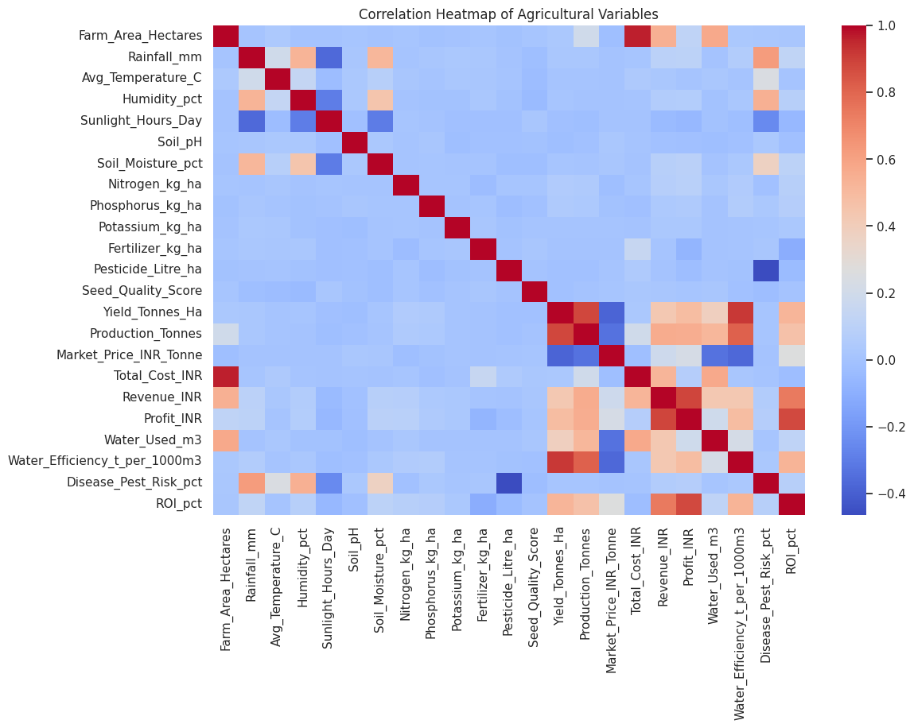
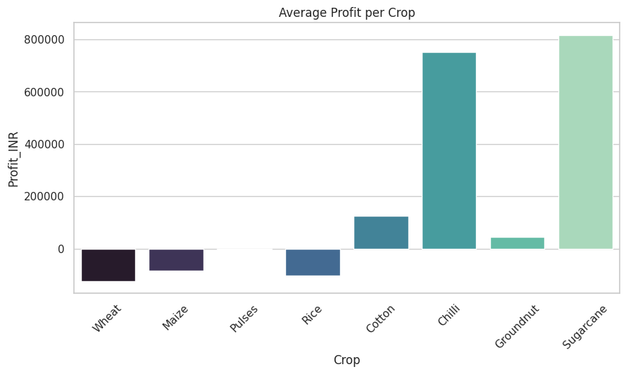
RESULTS – Bivariate & Correlation Analysis
Sugarcane and Chilli generate the highest average profit; Wheat, Maize and Rice show low or negative returns. The correlation heatmap confirms strong positive links between Yield, Production, Revenue and Profit.

Slide 9
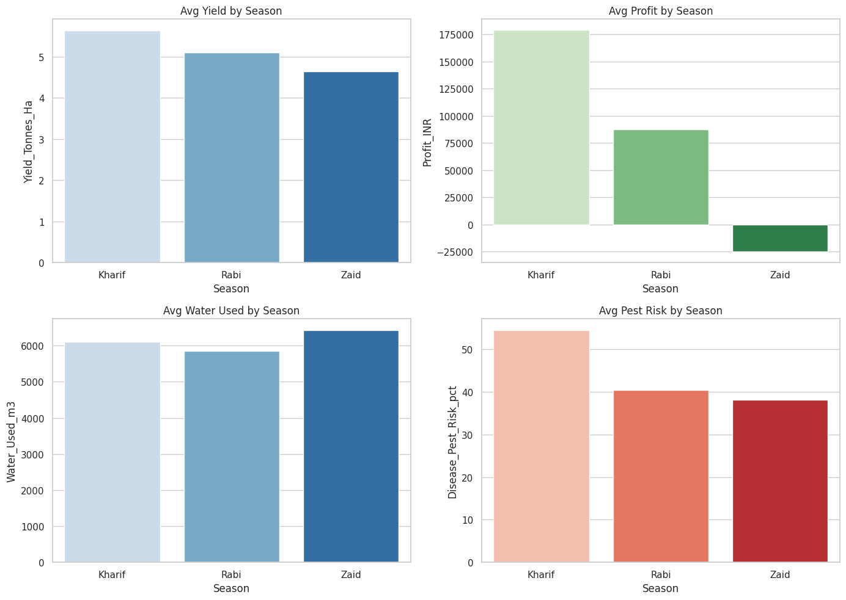
RESULTS Seasonal Performance Comparison
Kharif delivers the highest average yield and profit but carries the highest pest/disease risk. Zaid needs the most irrigation water despite the lowest yield and profit — often resulting in financial loss.

Slide 10
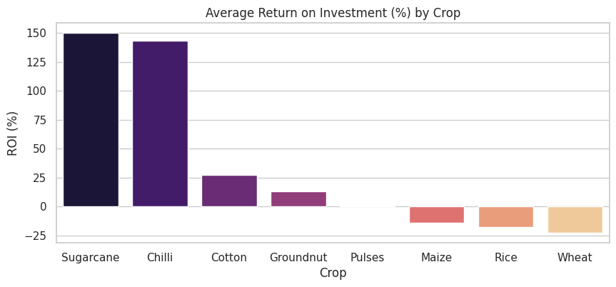
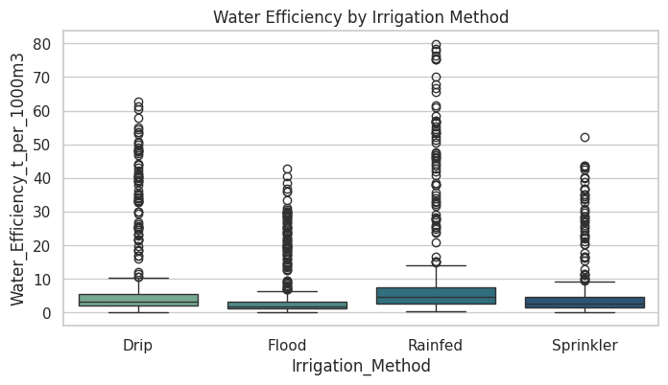
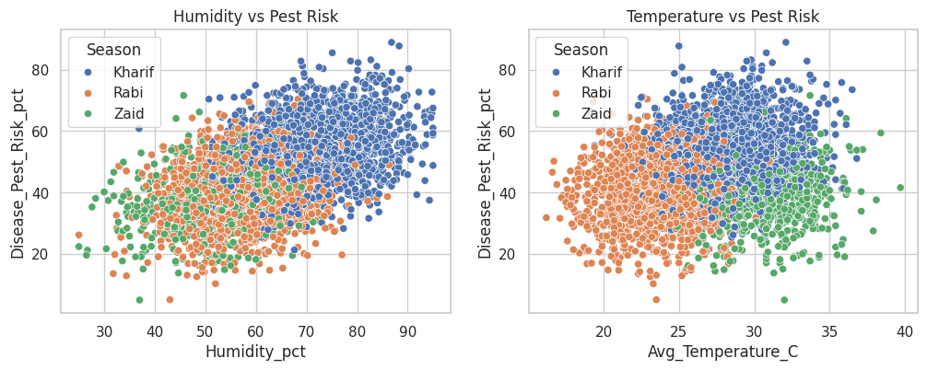
RESULTS – Custom Analysis: ROI, Irrigation & Pest Risk
Sugarcane and Chilli offer the highest ROI. Drip irrigation gives more consistent water efficiency than flood irrigation. Pest/disease risk rises sharply with humidity, peaking in the humid Kharif season.

Slide 11
Future scope
• Predictive Modeling: build ML models to forecast yield and profit based on season, crop and environmental conditions.
• Real-Time Data Integration: connect live weather and market-price APIs to keep recommendations current.
• Farmer-Facing Dashboard: turn the analysis into an interactive web/mobile app for farmers and advisors.
• Richer, Multi-Year Data: extend the dataset to track long-term soil health and extreme weather events.
• Region-Specific Climate Risk Models: tailor pest and water-risk predictions to local agro-climatic zones.

Slide 12
GitHub Link
https://github.com/sahilkumardhiwar96-hash/Seasonal-Agriculture-Performance-Analysis.git

Slide 13

VOIS Course completion certificate
Course name- Data Visualization

Slide 14
Thank you !
.
.

